Slide 1
Post Acute care Interoperability Working Group
Kickoff Meeting
February 26, 2019

Slide 2

Welcome!
Opening Remarks
Introductions
Review Meeting Agenda

Slide 3
Introductions
Name
Company
Title
Why are you interested in this effort?
What do you want to get out of this effort?
On a scale of 1-10 (10 highest), how familiar are you with Fast Healthcare Interoperability Resources (FHIR)?

Slide 4

“WHY” is a PAC Interoperability Working Group needed?
Proposed vision
Priorities and potential barriers
Role of the working group in “moving the needle”

Slide 5
IMPACT Act
Signed into law in 2014, the IMPACT Act requires:
Standardization of certain categories of data elements across the PAC assessment instruments and reporting the standardized data to CMS for quality, discharge planning, and other purposes.
Interoperability of standardized PAC patient/resident assessment data, allowing for the seamless transition of patient information between care settings.
Development and implementation of quality measures in five quality domains using these standardized patient/resident assessment data elements (SPADE), as well as the development and reporting of measures pertaining to resource use, hospitalization, and discharge to the community.

Slide 6
CMS: Notice of Proposed Rulemaking (NPRM) to Improve the Interoperability of Health Information
Patient Access to their claims and clinical information through Application Programming Interfaces (APIs)
Health Information Exchange and Care Coordination Across Payers
API Access to Published Provider Directory Data
Care Coordination Through Trusted Exchange Networks
Improving the Dual Eligible Experience by Increasing Frequency of Federal- State Data Exchanges
Public Reporting and Prevention of Information Blocking
Provider Digital Contact Information
Revisions to the Conditions of Participation (CoPs) for Hospitals and Critical Access Hospitals
Advancing Interoperability in Innovative Models
Request for Information (RFI) for PAC providers to provide feedback
Source: https://www.cms.gov/newsroom/fact-sheets/cms-advances-interoperability-patient-access-health-data-through-new-proposals

Slide 7
ONC: INTEROPERABILITY, INFORMATION BLOCKING, AND HEALTH IT CERTIFICATION PROGRAM PROPOSED RULE (1/3)
Pediatrics
Developed 10 recommendations for voluntary certification of health IT for pediatric care
Proposes to adopt new and revised certification criteria to support the voluntary certification of health IT for pediatric care
Conditions of Certification
Information blocking; assurances; communications; FHIR-based application programming interfaces (APIs); real world testing of certified health IT; and attestations
Interoperability Definition
Enables the secure exchange of electronic health information (EHI) with, and use of EHI from, other health IT without special effort on the part of the user
Allows for complete access, exchange, and use of all electronically accessible health information for authorized use under applicable state or federal law
Does not constitute information blocking
Source: https://www.healthit.gov/sites/default/files/nprm/ONCCuresNPRMImplementation.pdf

Slide 8
ONC: INTEROPERABILITY, INFORMATION BLOCKING, AND HEALTH IT CERTIFICATION PROGRAM PROPOSED RULE (2/3)
Information Blocking
Proposes seven categories of practices that would be considered reasonable and necessary that, provided certain conditions are met, would not constitute information blocking. These categories were developed based on feedback from stakeholders and consultation with appropriate federal agencies
If the actions of a regulated actor (health care provider, health IT developer, or health information exchange or network) satisfy an exception, the actions would not be treated as information blocking and the actor would not be, as applicable, subject to civil penalties or other disincentives under the law
Exceptions include: Preventing harm, promoting the privacy of EHI, promoting the security of EHI, recovering costs reasonable incurred, responding to requests that are infeasible, licensing of interoperability elements on reasonable and non discriminatory terms, maintaining and improving health IT performance
Exchange with Registries
Includes a Request for Information (RFI) on how a standards-based API might support improved information exchange between a health care provider and a registry in support of public health reporting, quality reporting, and care quality improvement
Source: https://www.healthit.gov/sites/default/files/nprm/ONCCuresNPRMImplementation.pdf

Slide 9
ONC: INTEROPERABILITY, INFORMATION BLOCKING, AND HEALTH IT CERTIFICATION PROGRAM PROPOSED RULE (3/3)
Patient Access
Promotes policies that would ensure a patient’s EHI is accessible to that patient and the patient’s designees
US Core Data for Interoperability (USCDI)
Specifies a common set of data classes required for interoperable exchange and identifying a predictable, transparent, and collaborative process for achieving 21st Century Cures Act goals
Trusted Exchange Framework and Common Agreement (TEFCA)
Guardrails and general principles that Qualified Health Information Networks (QHINs) and Health Information Networks (HINs) should follow to engender trust amongst Participants and End Users
Specific terms and conditions that will be incorporated into a single Common Agreement by a Recognized Coordinating Entity (RCE)
Source: https://www.healthit.gov/sites/default/files/nprm/ONCCuresNPRMImplementation.pdf

Slide 10
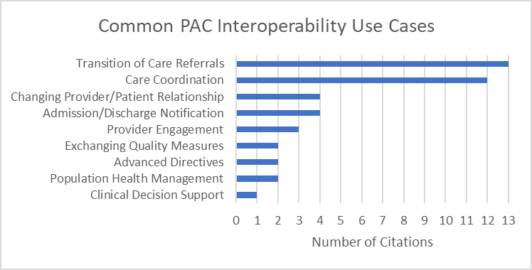
Landscape Analysis findings (1/3)

Slide 11
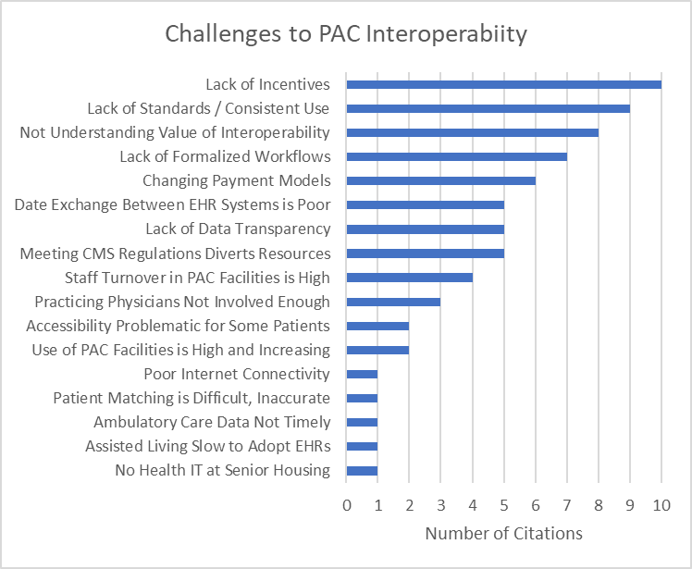
Landscape Analysis findings (2/3)

Slide 12
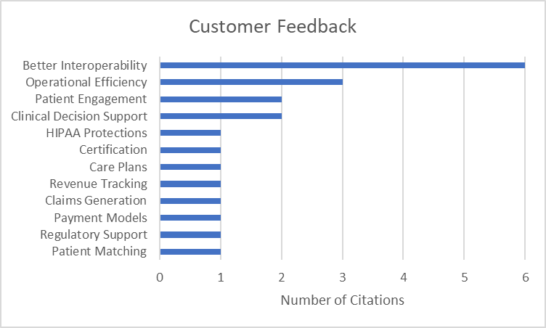
Landscape Analysis findings (3/3)
*
*This information was collected from vendors who described their customer feedback

Slide 13
The Time is Now!
Multiple efforts are underway to define FHIR Implementation Guides
PAC is an integral part of the health care spectrum and affects 45% of patients after hospitalization
Need to ensure PAC needs are addressed as HIT interoperability standards evolve
Need to remain coordinated to prevent FHIR silos
Source: RTI International analysis of 2014 Medicare claims under contract with the Assistant Secretary for Planning and Evaluation, August 2018 (aea0315).

Slide 14
Priorities
Reach consensus on governance, purpose, and goals
Decide on a tightly-scoped use case or use cases
Reuse / adapt / develop FHIR implementation guides for data models

Slide 15
ANTICIPATED Challenges
“Speed of consensus”
Resolving incompatibilities with existing FHIR Implementation Guides, specifically negotiating inclusion of missing items needed to enable reuse for PAC

Slide 16

“WHAT” the PAC Interoperability Working Group should be
Development/Refinement of Guiding Principles, Goals, and Practices
Definition of success

Slide 17








HL7® FHIR® Accelerator Program
The HL7 FHIR Accelerator Program is designed to assist implementers across the health care spectrum in the creation of FHIR Implementation Guides or other informative documents
FHIR for Clinical Care
FHIR Solutions for VBC
FHIR Consumer Solutions
The purpose of the Argonaut Project is to rapidly develop FHIR-based API and Core Data Services specifications to enable expanded information sharing for electronic health records and other health information technology based on Internet standards and architectural patterns and styles.
HL7 Sponsored
Solutions to VBC Use Cases
The goal of the Da Vinci project is to help payers and providers to positively impact clinical, quality, cost and care management outcomes.
Enabling consumers and their authorized caregivers to access more of their digital health information with less friction.
Provider/Provider, Provider/Consumer
Payer/Provider
Payer/Consumer
Coordination across existing and future FHIR initiatives
HL7 FHIR Accelerator Program
HL7 FHIR Foundation
ONC FHIR at Scale Taskforce (FAST)

Slide 18
Working Group Goals
Promote interoperability
Develop open, standard, non-proprietary APIs
Enable fine-grain modularity
Promote reusability
Promote innovation
Support migration path
Establish trust framework for nationwide information exchange

Slide 19
Working Group Principles
Define a prioritized set of use cases for PAC data (DEL + ??)
All data and functionality should be exposed through APIs
APIs should be documented
Standardize APIs, not internals
Focus on data standards and resource definitions
Design APIs to interface to the outside world, even if that is not the immediate intent
Hide internal implementation details through APIs
Keep API technology-agnostic - It doesn’t matter what technology is used in the implementation
Develop APIs that are FHIR-based, RESTful and stateless
Make API simple for consumers, so they are easier to use and replace
Make APIs transparent and reusable

Slide 20
Deliverables
Development of:
A PAC / DEL common data set for release in a FHIR API
Appropriate FHIR resources for the PAC Data Set
A set of data query profiles that will define the minimum mandatory data elements, extensions, and terminology requirements that must be present in the FHIR resource(s)
Implementation guides for PAC providers to release PAC Data Set information
A reference implementation that can be validated at a future connectathon
Educational resources for providers and consumer advocates (including family caregivers) for how to access and use their health information
Educational resources for policy-makers education on the benefits of the DEL and other resources

Slide 21
“HOW” the PAC Interoperability Working Group operates
Governance
Required commitment
Meeting frequency/timing
Branding
Collaborations
Communications
Licensing

Slide 22
Governance
Leadership
Project Management: Dave Hill, MITRE
Task group leaders
Consensus Decision-making
Principle One: Seek informed consensus but there is not a requirement to get perfect agreement
Principle Two: It is the duty of the leader to declare when a consensus exits
Principle Three: Recognize and report minority opinions
Principle Four: Continuously move toward a productive conclusion

Slide 23
ROles and responsibilities of CMS and ONC
Starting the Post Acute Care Interoperability Work Group
Participating in Work Group efforts and engaging with stakeholders
Assisting with the transition of efforts to industry to meet long term goals of interoperability

Slide 24
Commitment
What does it mean to be a “committed member”?
Building on the success of DaVinci, Argonaut, and the CARIN projects, participants who join the workgroup must be “meaningful, active contributors” to the overall success of the project.
Those contributions include but are not limited to:
Knowledge of the subject matter
Scalability of implementing the eventual solution
Willingness to assist in the delivery of key deliverables and project artifacts
Assistance in testing frameworks
The project leadership team will meet with each participant to discuss ways in which they plan to contribute to this overall effort.
The working group(s) will only involve individuals and organizations who are actively making meaningful contributions to the overall success of the project based on the discretion of the project leadership team.

Slide 25
Meeting frequency / timing
Program Meetings – monthly, one-hour
Observers and passive involvement
Project / Task meetings – weekly, one-hour
Meaningful, active contributors who are gaining consensus on the building and testing of the FHIR implementation guides

Slide 26
Branding
Name
Must be eligible for trademarking
Must have an available domain
E.g. <name>.org, project<name>.org, <name>project.org, etc.
Logo
Website

Slide 27
Collaborations
HL7 Argonaut Project
CARIN Alliance
Blue Button 2.0
Da Vinci Project
Project Poplin
HL7 Patient Care Working Group
HL7 Payers Working Group
Others?
Who can act as liaisons?

Slide 28
Communications
Messaging (e.g. Slack)
Project Tracking (e.g. Trello)
Project Meetings (e.g. Skype)

Slide 29

Wrap up
Reflections and Remarks
Meeting Feedback
Clarification of Next Steps

Slide 30
Reflections and Remarks

Slide 31
NEXT STEPS (1/2)
March
Reach consensus on today’s topics
Vote
Decide on use case(s) to implement
Review proposed use case
April
Identify data models for use case(s)
Search for existing FHIR IGs for those data models
Adapt FHIR IGs as needed and start discussions with owning group
Start to develop new FHIR IGs, if necessary, to close remaining gaps
May
Develop new FHIR IGs
Divide use case into tightly-scoped agile pieces
Propose alternatives

Slide 32
NEXT STEPS (2/2)
June
Finalize FHIR IGs for use case
Start developing reference implementation of use case
Identify / develop testing frameworks
July
Develop reference implementation
Perform agile functional testing
August
Finalize reference implementation development
Perform system-level testing
September
Make final preparations for HL7 Working Group connectathon
Hold Connectathon in Atlanta – September 14, 15

Slide 33
homework
How to be a meaningful contributor?
Think about governance
Discuss and vote as possible
Review use case
How should use case be divided up?
Generate a prioritized list of what part(s) of use case should be tackled first?
Set-up calls with meaningful contributors

Slide 34
Meeting Feedback

Slide 35
backup

Slide 36
Use Case Scenario: Patient’s Sequence of Events
Home
Hospital B
SNF
Hospital A
Home with HHA
Ms. Smith sees cardiologist for symptom management
Cardiologist increases Furosemide dosage.
Ms. Smith is admitted to the hospital for signs and symptoms of sepsis
Providers rely on Ms. Smith’s memory to recall PMH, which leads to medication errors
Medication error lead to an extended hospital stay with functional decline, requiring home health services upon discharge
Ms. Smith’s start of care is postponed due to a delayed face to face signature
Ms. Smith forgets her discharge paperwork in the hospital and obtaining another copy leads to delays in communication with specialists
Ms. Smith is admitted to Hospital B, which does not have Ms. Smith’s prior medical history. Providers rely on Ms. Smith’s verbal recall of PMH
Ms. Smith requires a right hip replacement
Ms. Smith is unable to recall her new activity restrictions and the SNF staff are unable to verify information upon admission
Ms. Smith subsequently experiences a fall and is readmitted to Hospital B
Physical Therapist (PT) recommends continued therapy in a Skilled Nursing Facility (SNF)
Ms. Smith falls and breaks her right hip requiring a hospital admission
Cardiologist faxes updated health information to PCP, but PCP does not receive
PATIENT IMPACT: Ms. Smith experiences an extended hospital stay due to a medical error caused by an incomplete past medical history collected by Hospital A. The extended hospital admission caused functional decline requiring Ms. Smith to use home health services. Miscommunication between the hospital and the home health agency led to a delay in services contributing to a fall. After her admission to hospital B, poor health information exchange between the SNF and hospital led to a readmission. Ultimately, Ms. Smith experienced a decrease in her quality of life, increased dependence on family and friends for support, and increased Medicare resource utilization.

Slide 37

Use Case Scenario: Ineffective Information Exchange
Third party software used to share information
Hospital providers must call PCP to reconcile information
Hospital has to rely on fax to transmit/ receive information from the HHA
Outpatient
Provider
No formal workflow for communicating health information
Hospital A providers
Home Health Agency
Hospital B
Skilled Nursing Facility
Paper records used for hand off
Paper records used for hand off
Fax transmission failed
Paper records used for hand off
Paper records used for hand off
Emergency Medical Services
Emergency Medical Services
EMS not connected to PCPs EHR & dependent on patients verbal recall
EMS not connected to HHA’s EHR & dependent on Ms. Smith’s verbal recall
Ms. Smith is responsible for communicating hospital encounter with PCP and dependent on printed paper discharge instructions
Transport Services
Ms. Smith does not get a copy of health information
Primary Care Physician

